Slide 1

Techzenure Technical Training 3rd week
Mentor : Ram Kumar Sir
Sirigiri.Lohit.Reddy
NO:8
(22-07-2023)

Slide 2
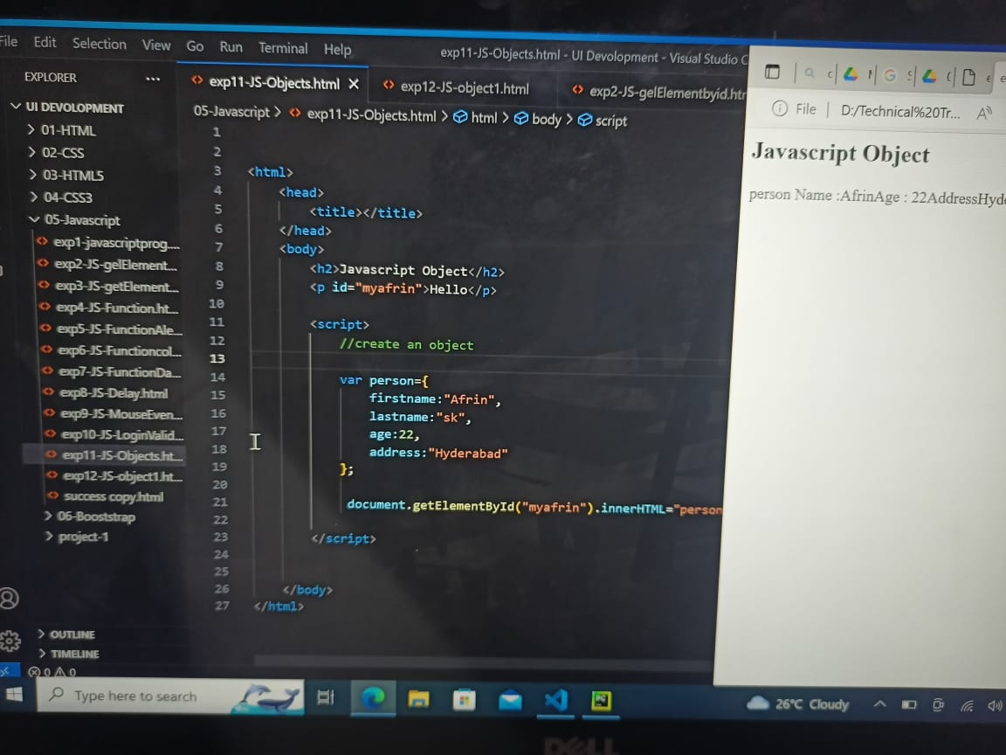
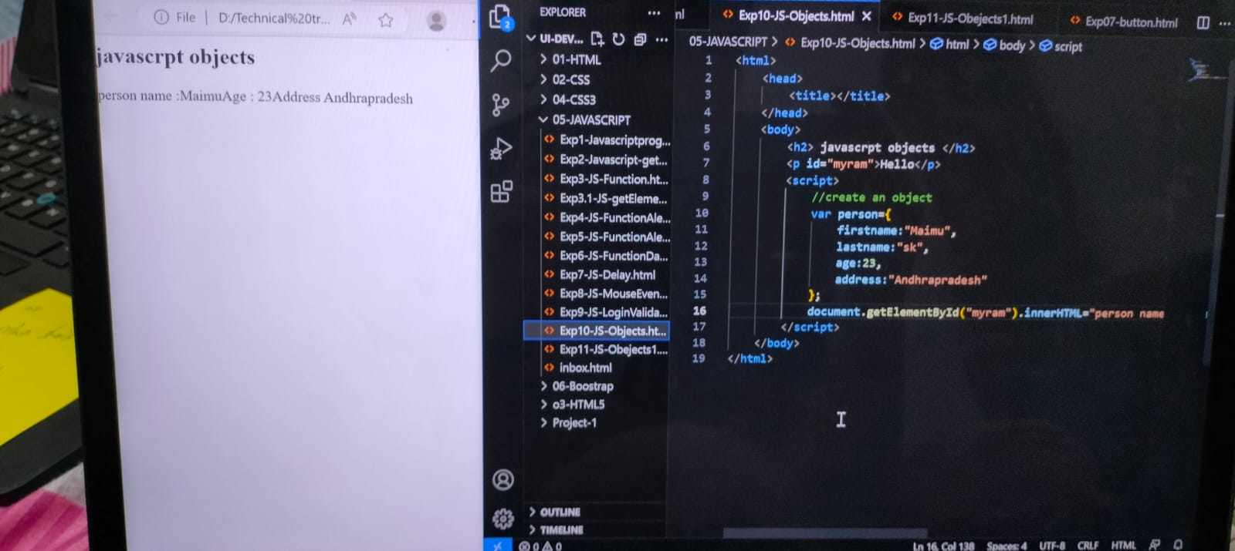
Javascript object1:

Slide 3
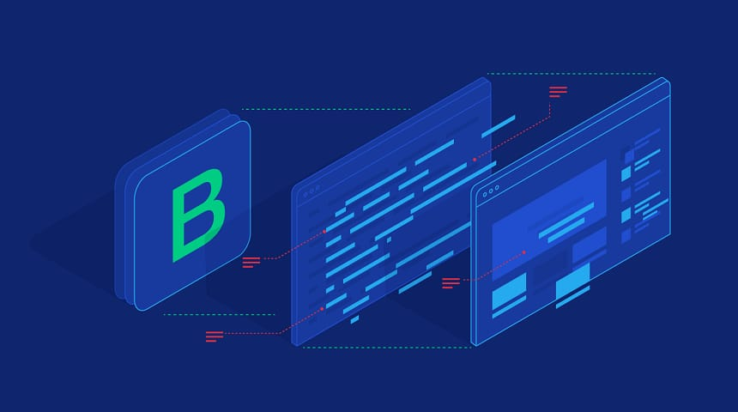
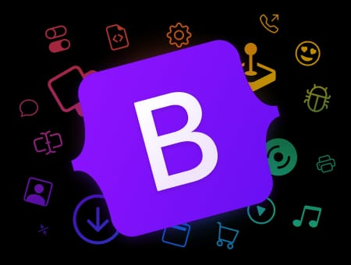
Bootstrap:- Bootstrap means to boot or to load a program into a computer using a much smaller initial programme to load in the desired programme which is usually in operating system.

Slide 4
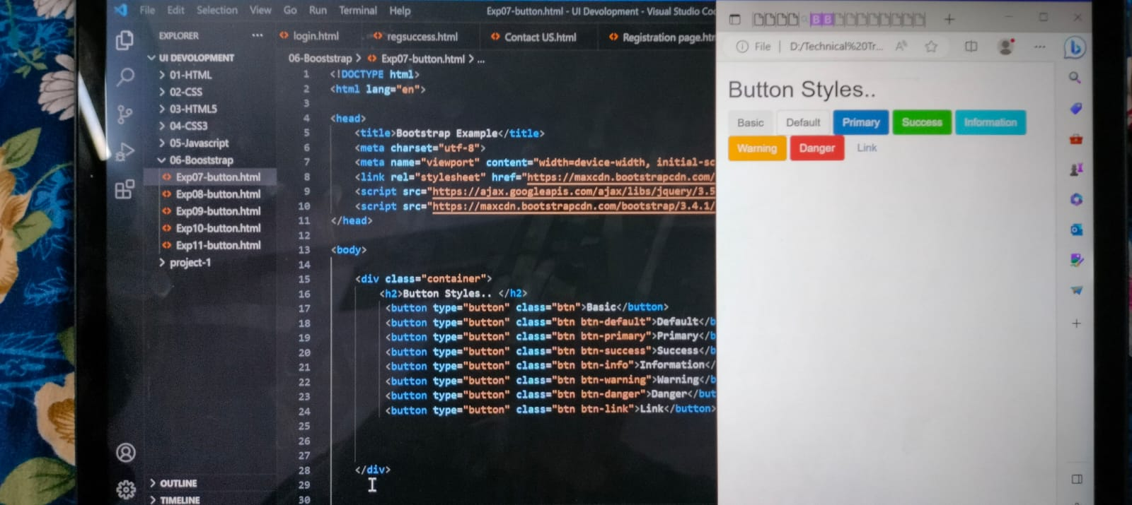

Slide 5
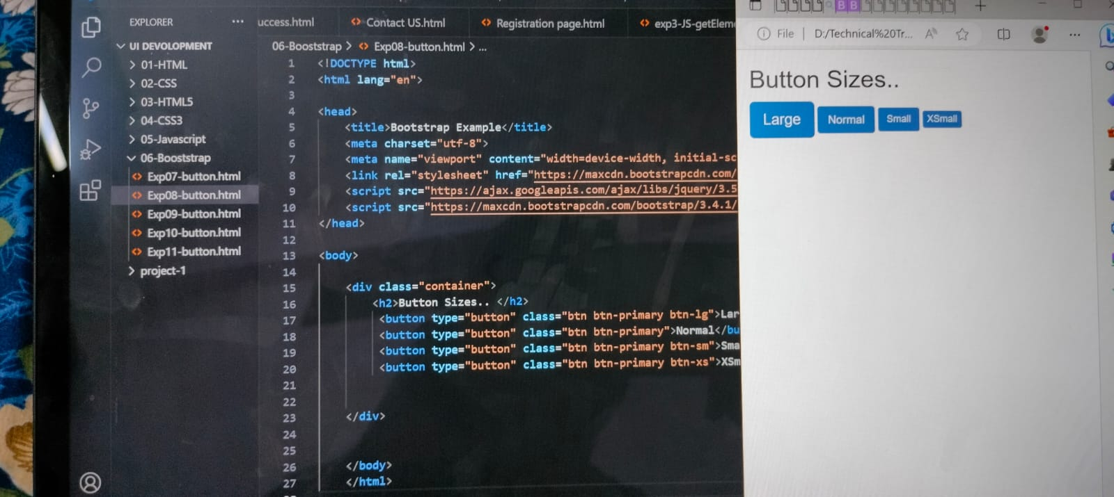

Slide 6
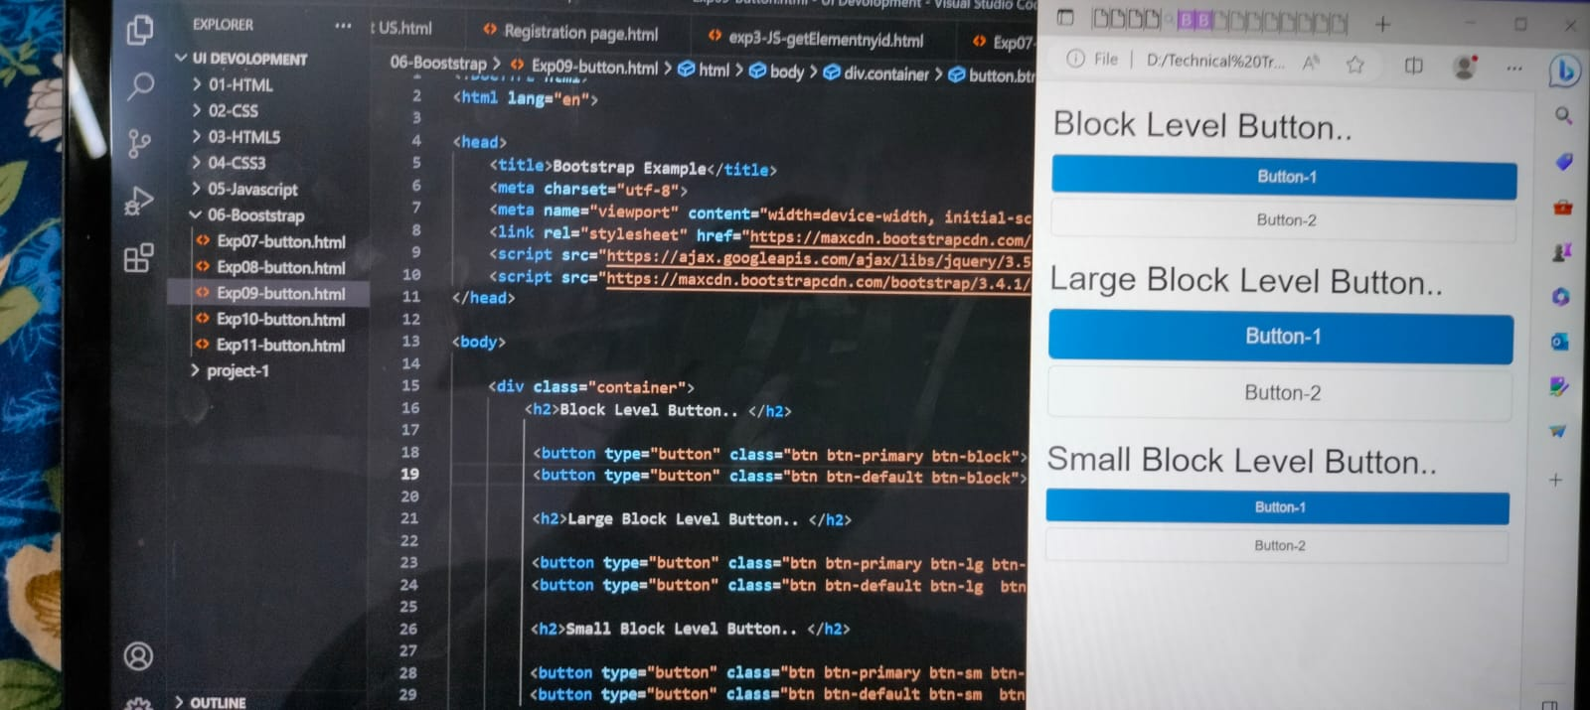

Slide 7
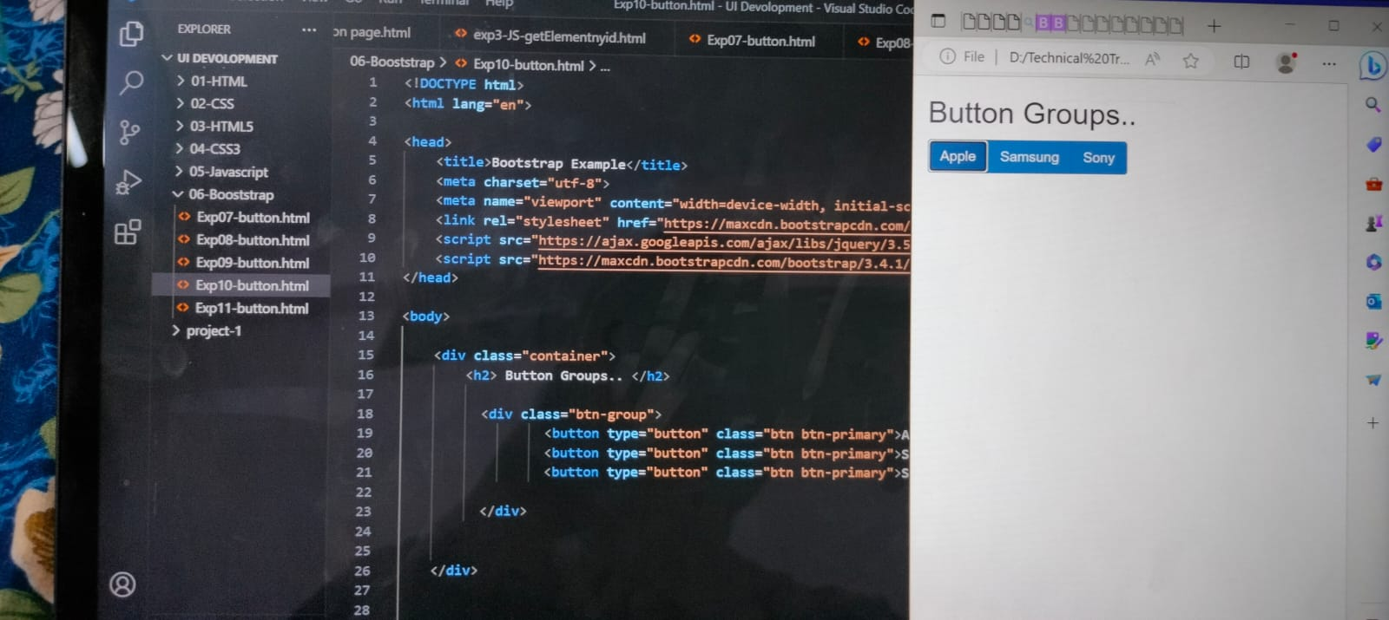

Slide 8
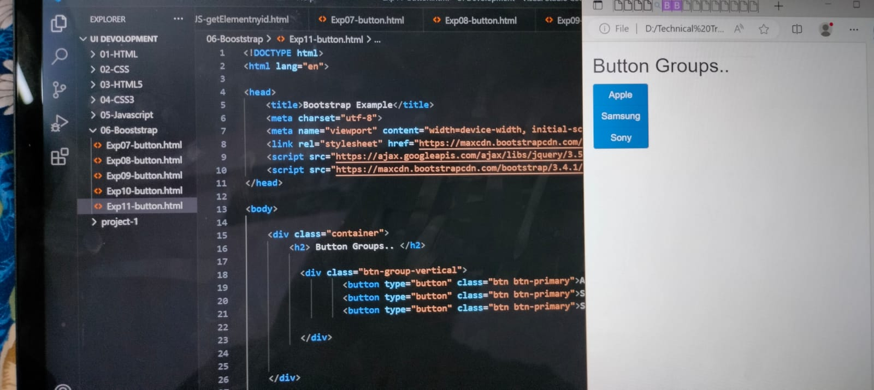

Slide 9
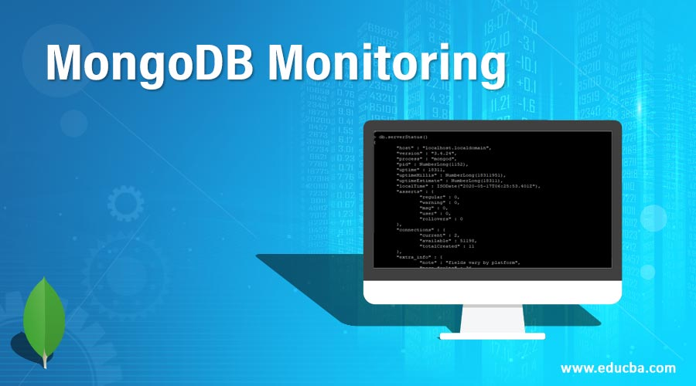
Mongodb:-
Mongodb is a non-relation document
Database that provides support for
JSON-like storage. The mongodb database
as a flexible data model that enables you
to store unstructured data.

Slide 10
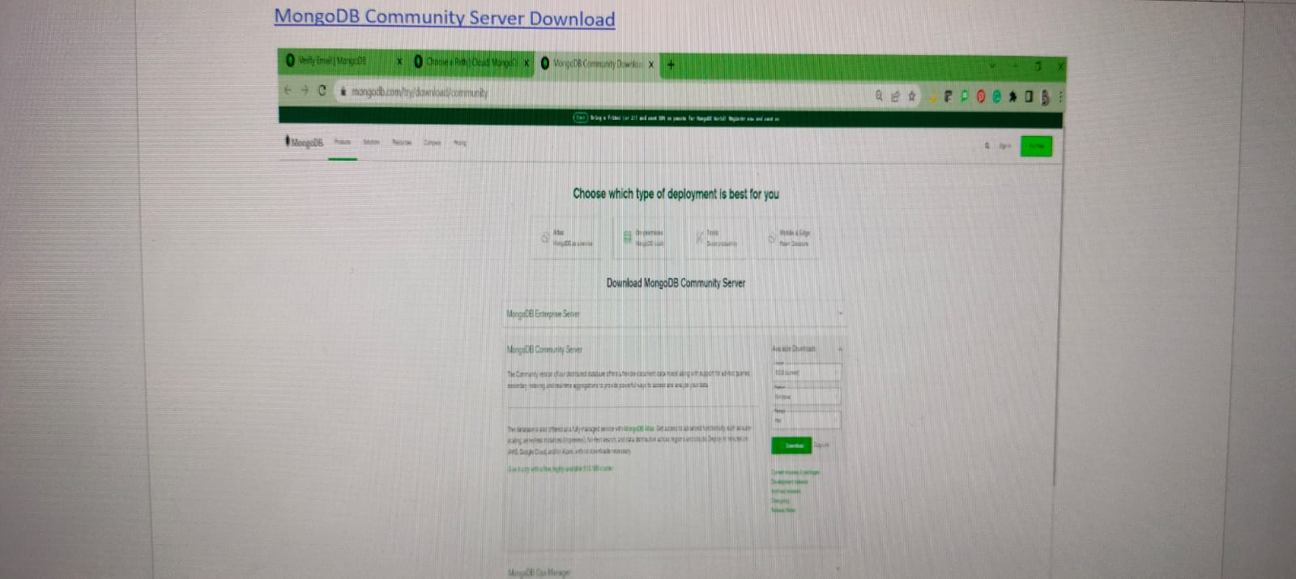
Mongodb installation:-

Slide 11
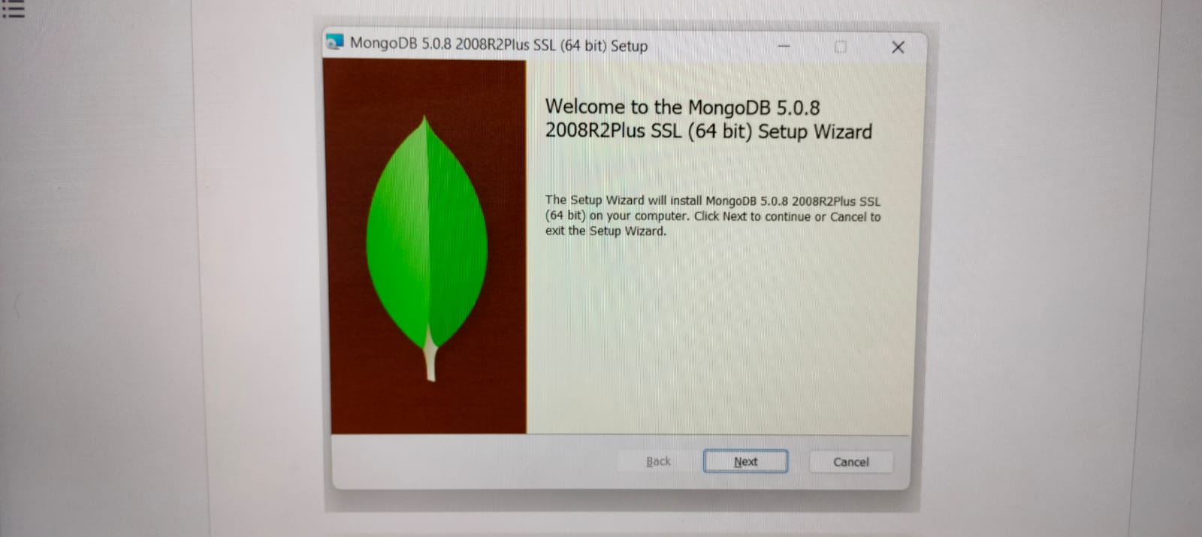

Slide 12
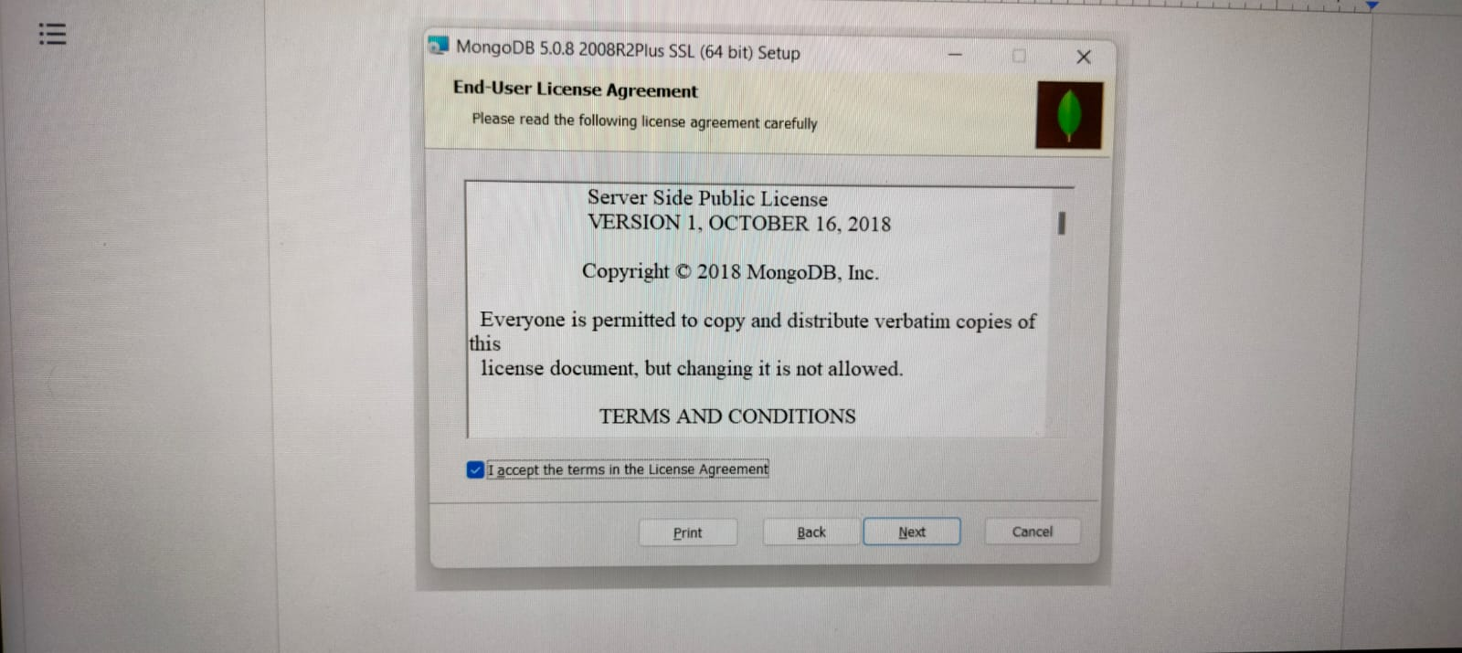

Slide 13
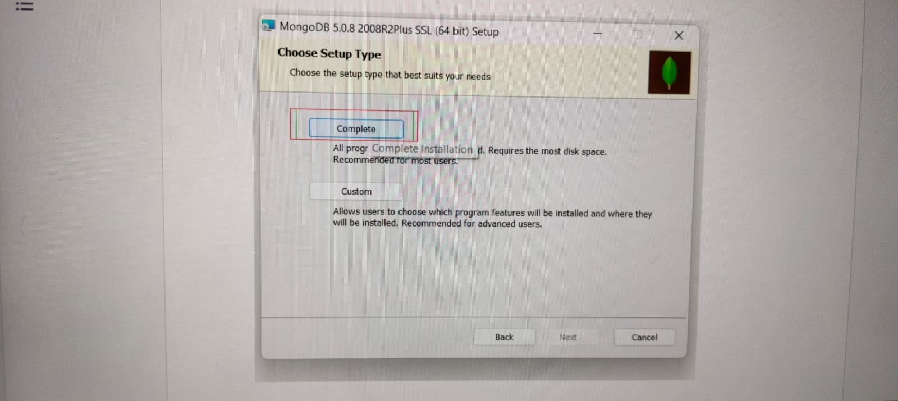

Slide 14
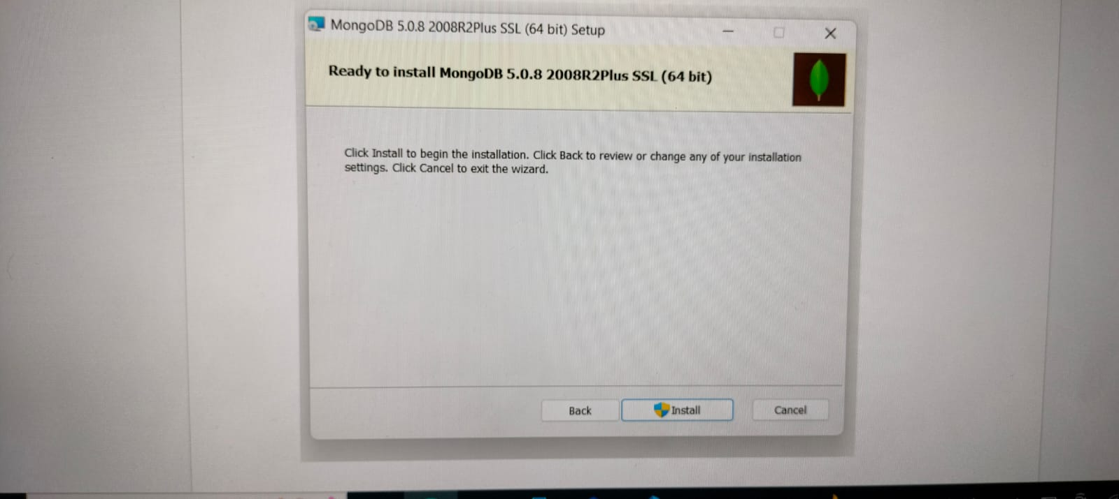

Slide 15
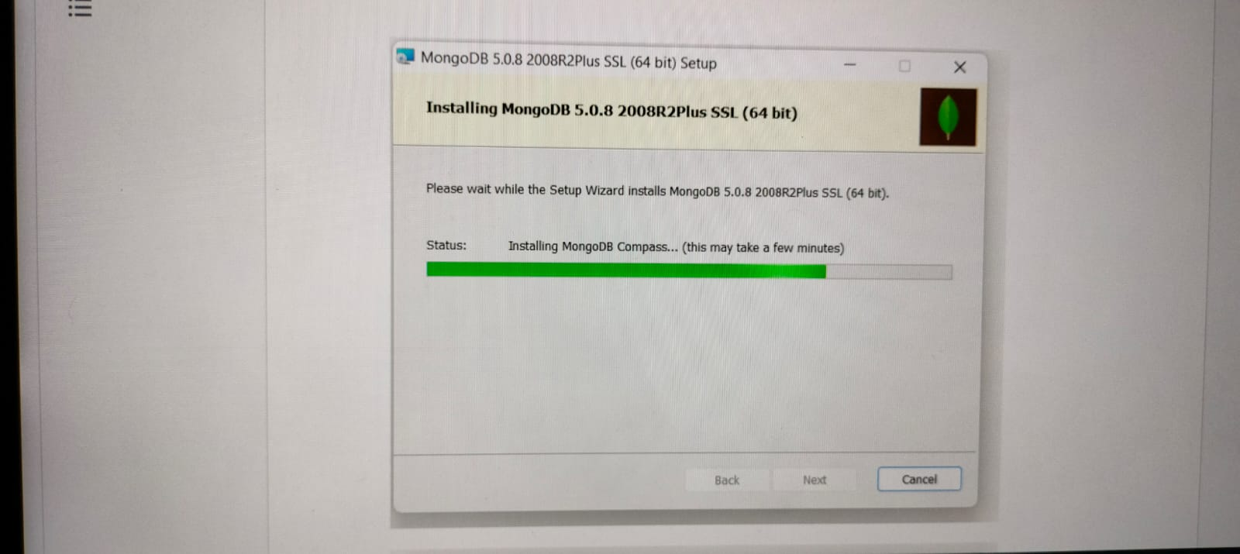

Slide 16
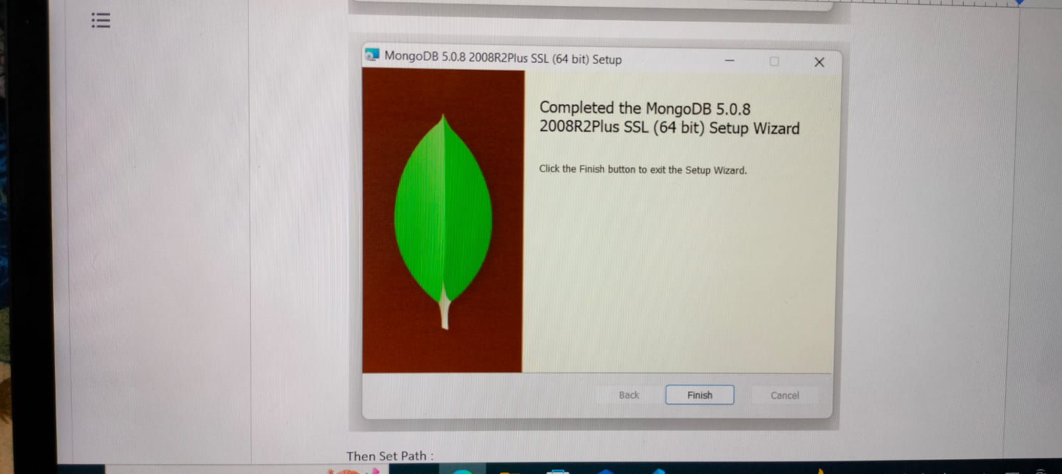

Slide 17
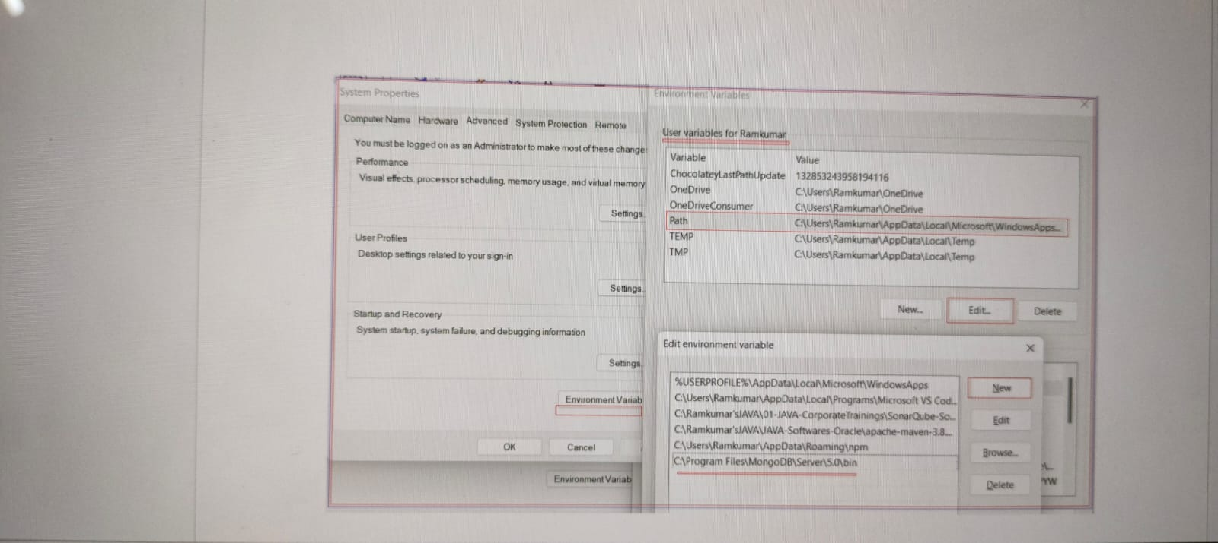
Setting path to mongodb:-

Slide 18
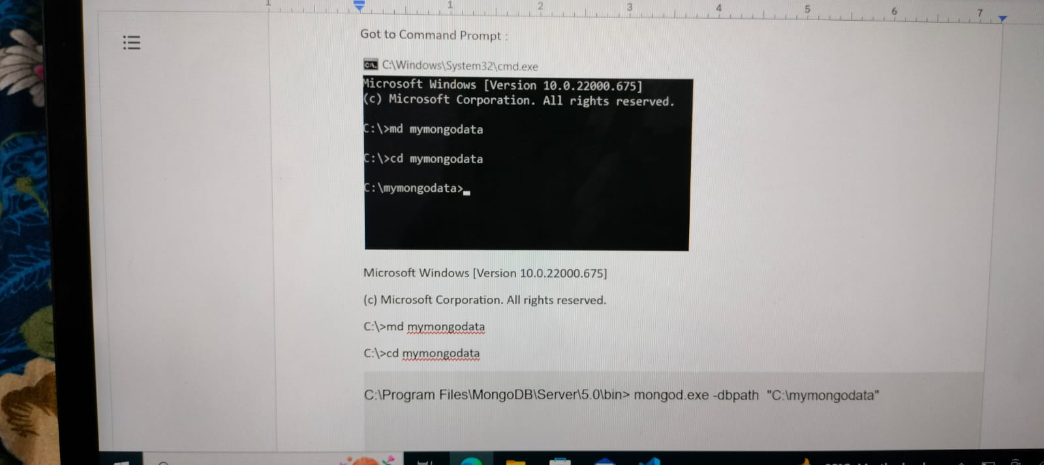
Command prompt:-

Slide 19
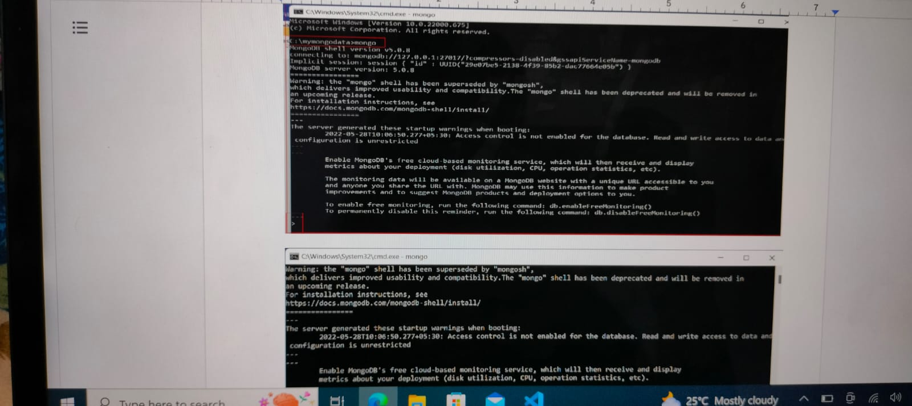

Slide 20
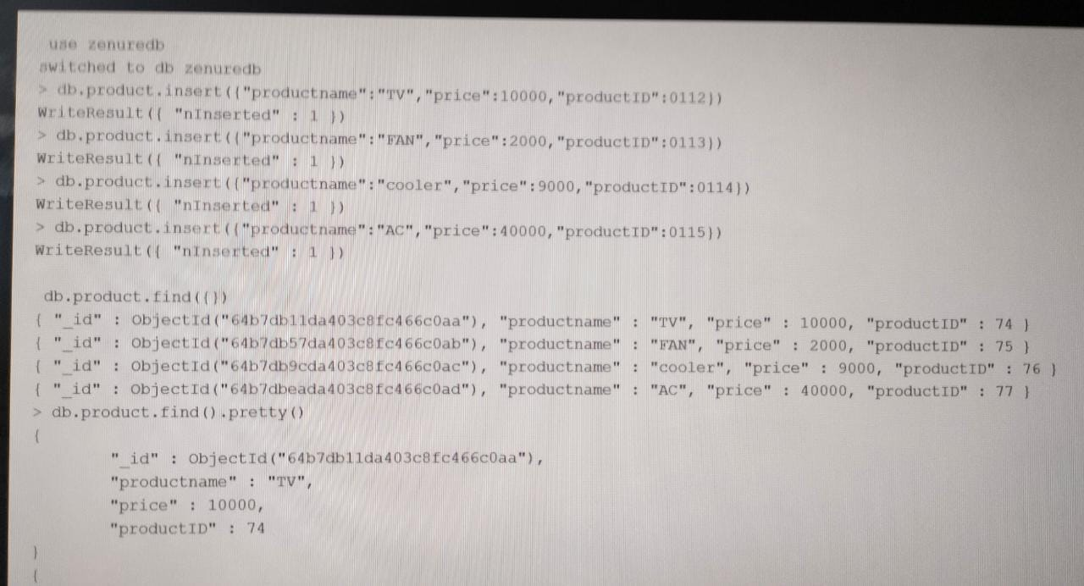
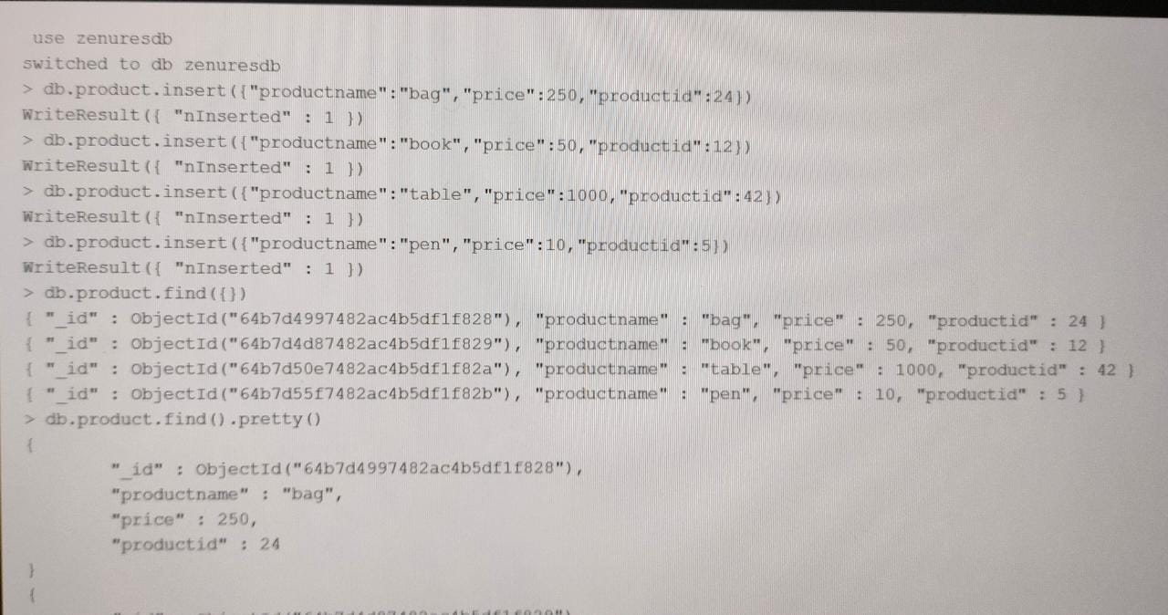
Creating tables using mongodb:-

Slide 21
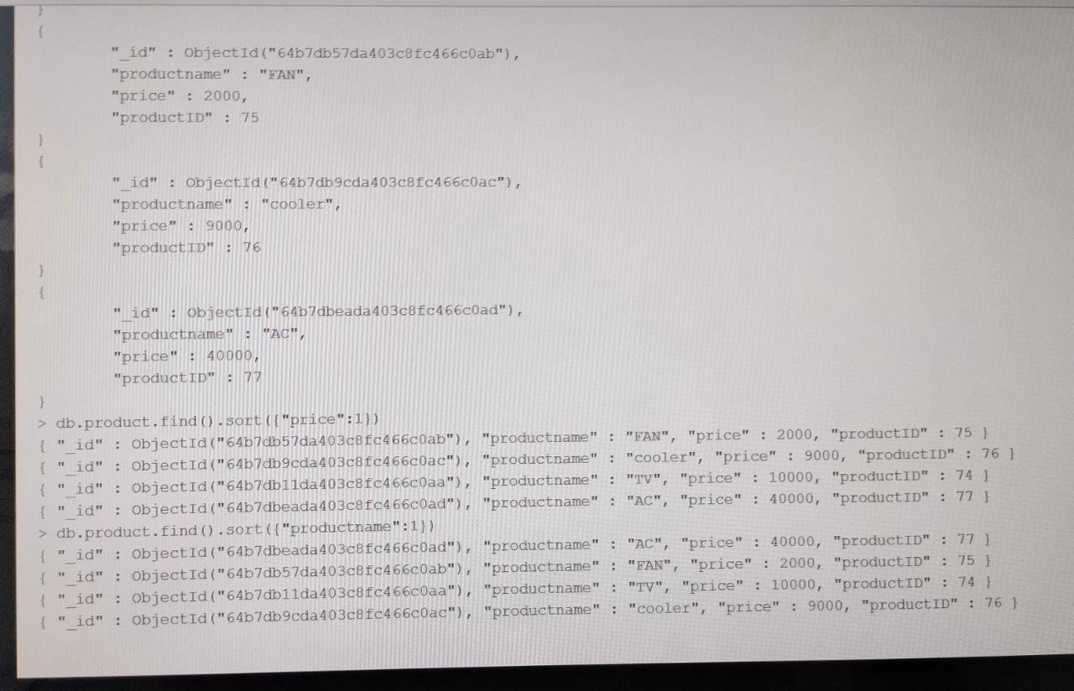

Slide 22
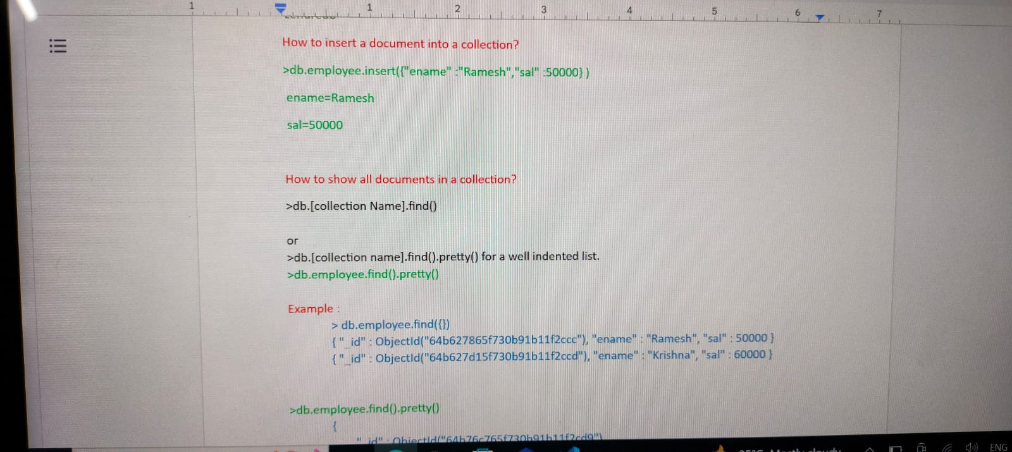

Slide 23
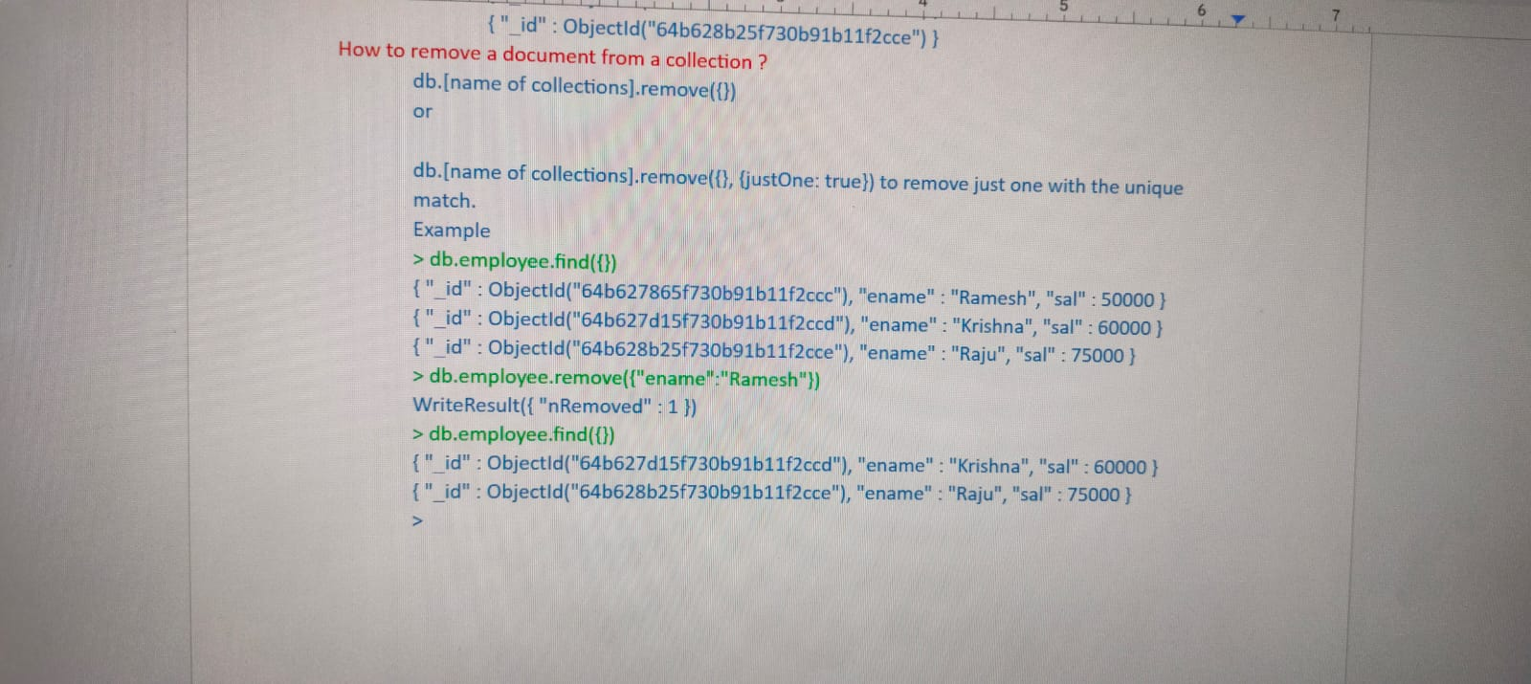

Slide 24
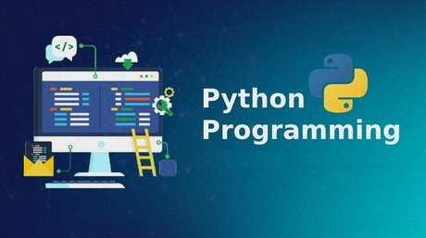
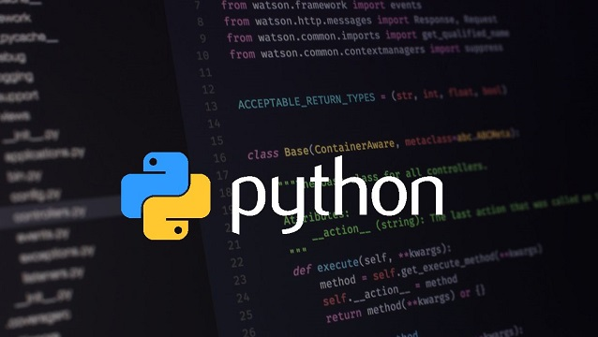
Python:-
Python is a computer programming language
often used to build websites and software,
automate tasks and conduct data analysis.
Python is a general-purpose language,
meaning it can be used to create a variety
Of different programs.

Slide 25
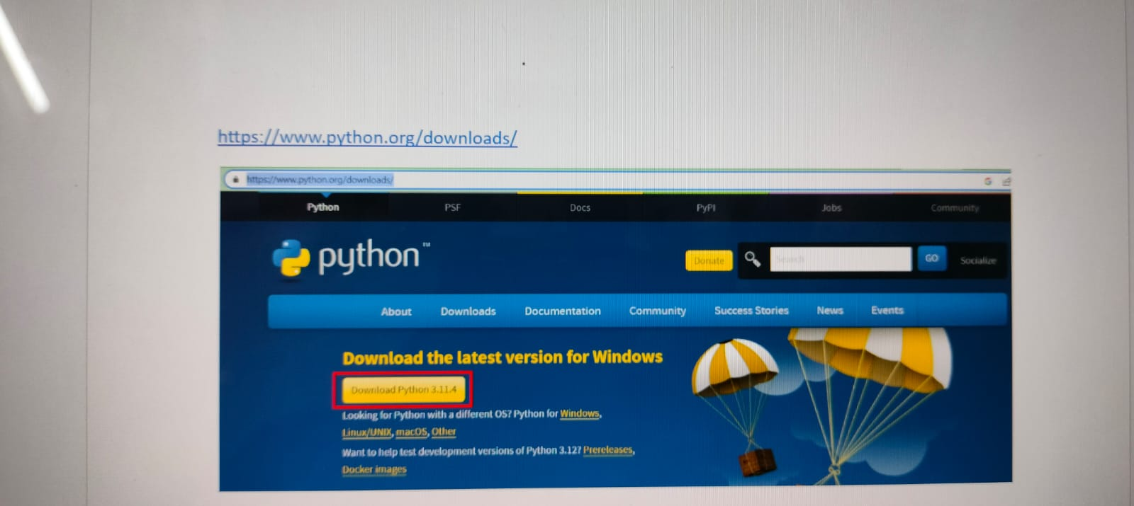
Python installation:-

Slide 26
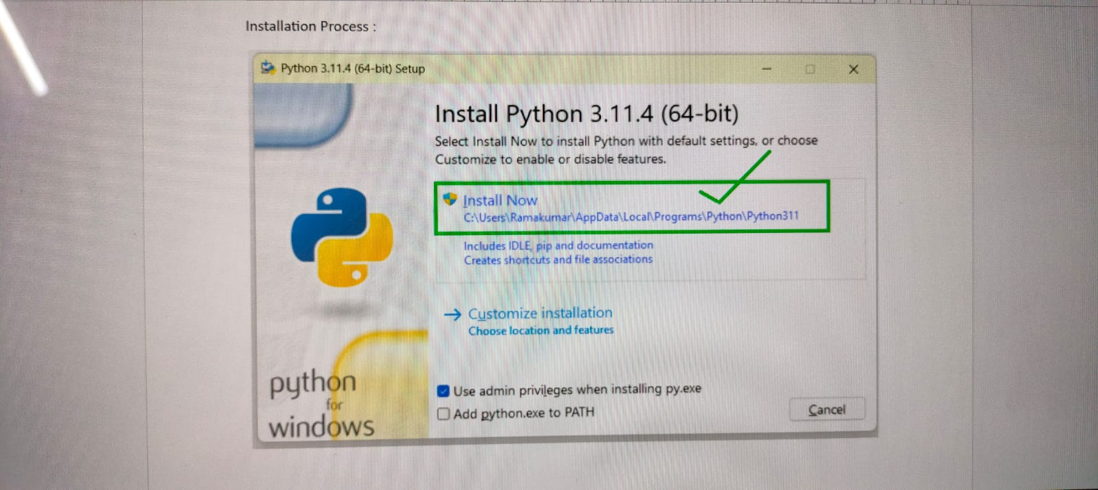

Slide 27
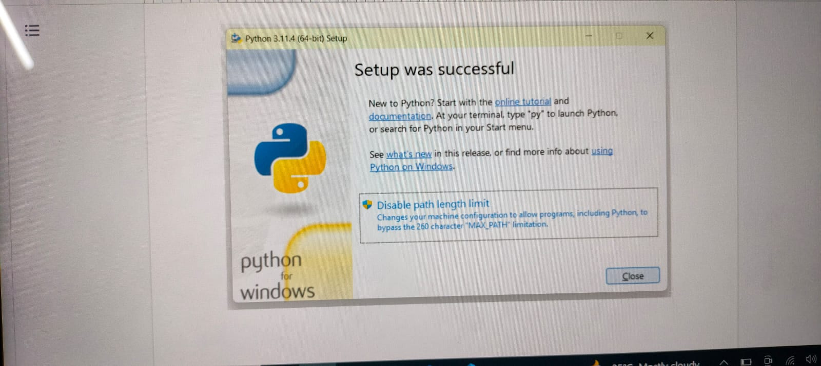

Slide 28


Slide 29
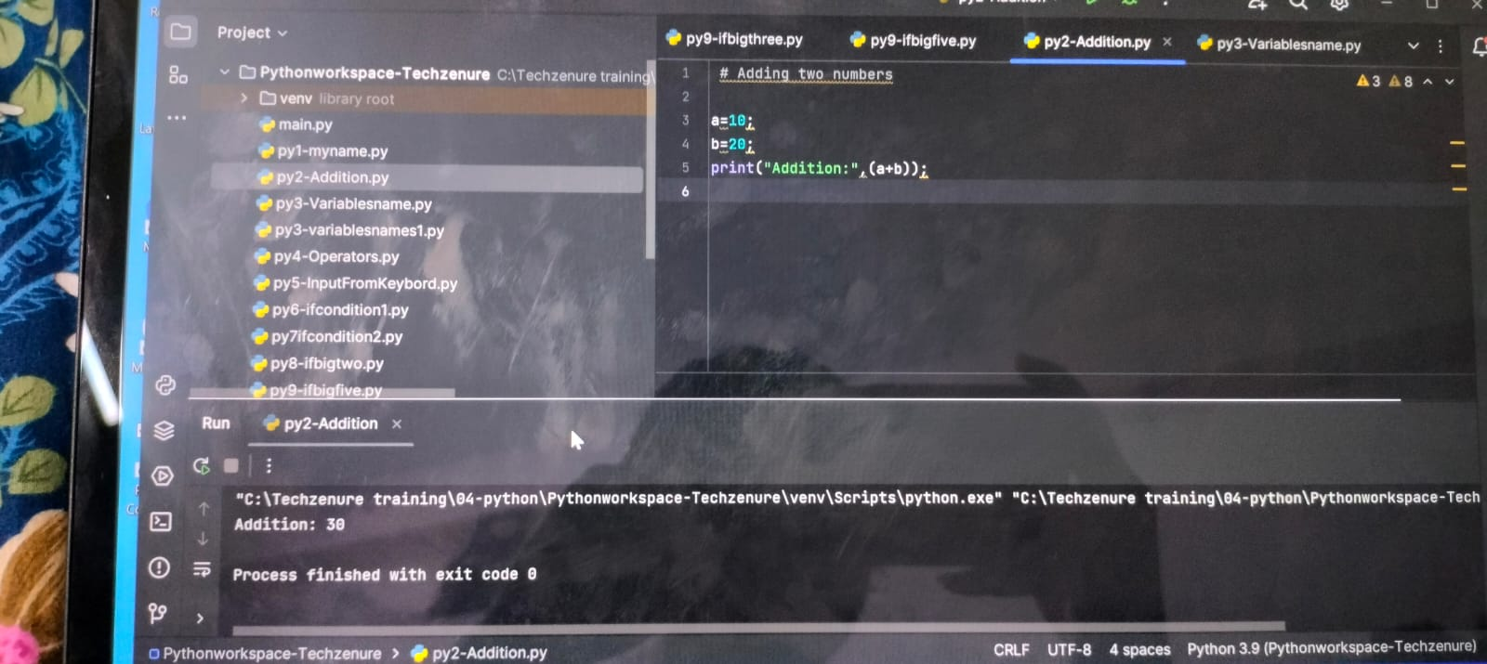
Python programs:- Addition program:-

Slide 30
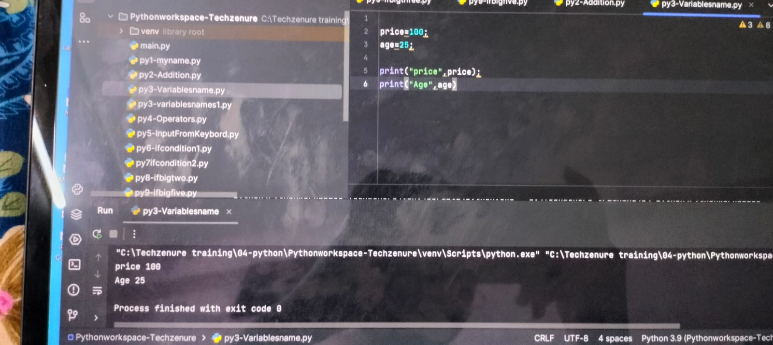
Variables program:-

Slide 31
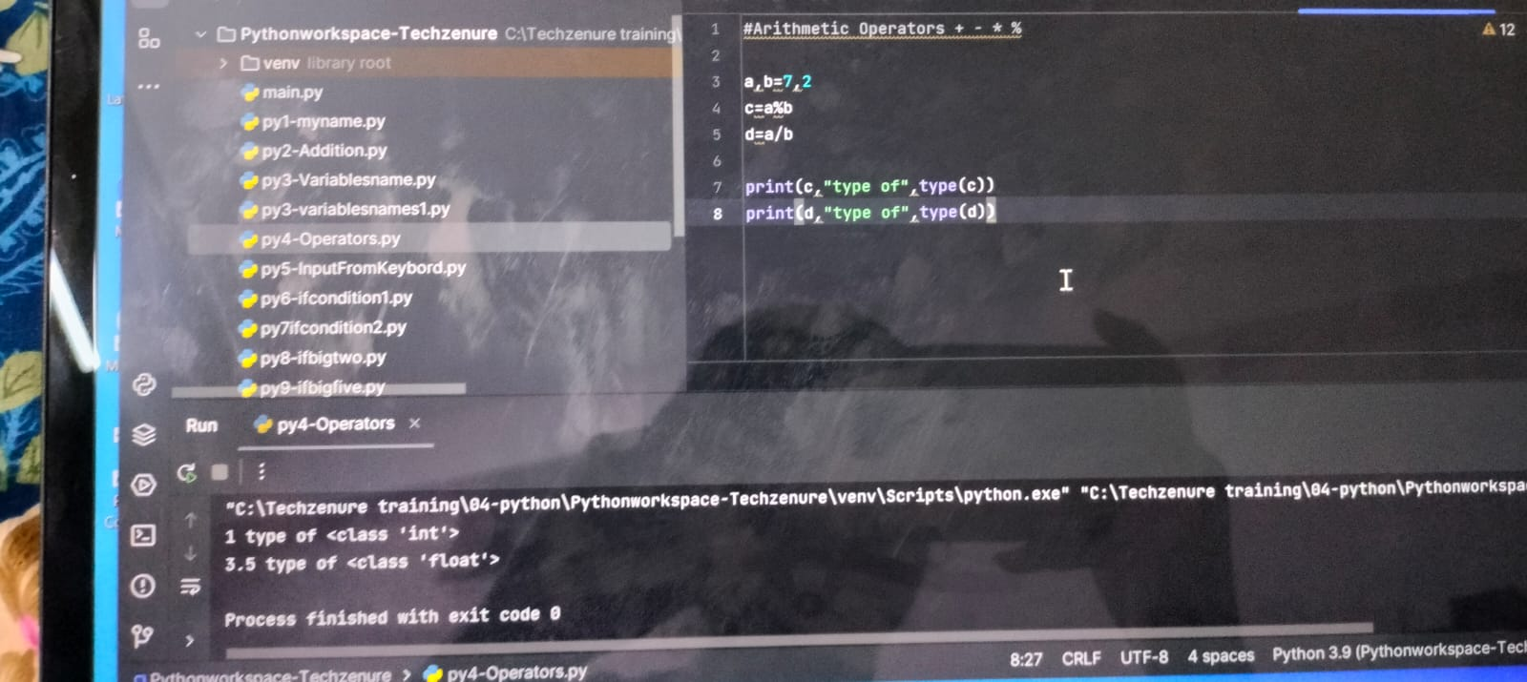
Operators(Arithmetic operators +,-,*,%)

Slide 32
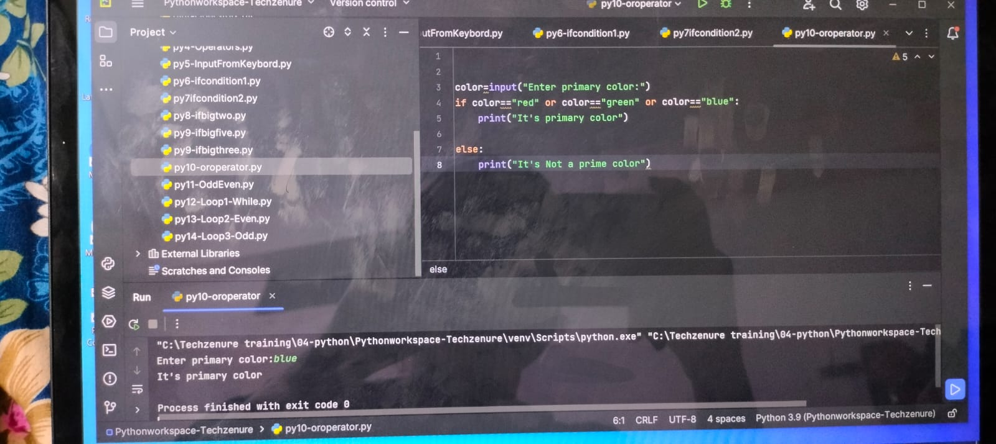
OR operator program:- In OR operator both statements must be true(t+t=t)

Slide 33
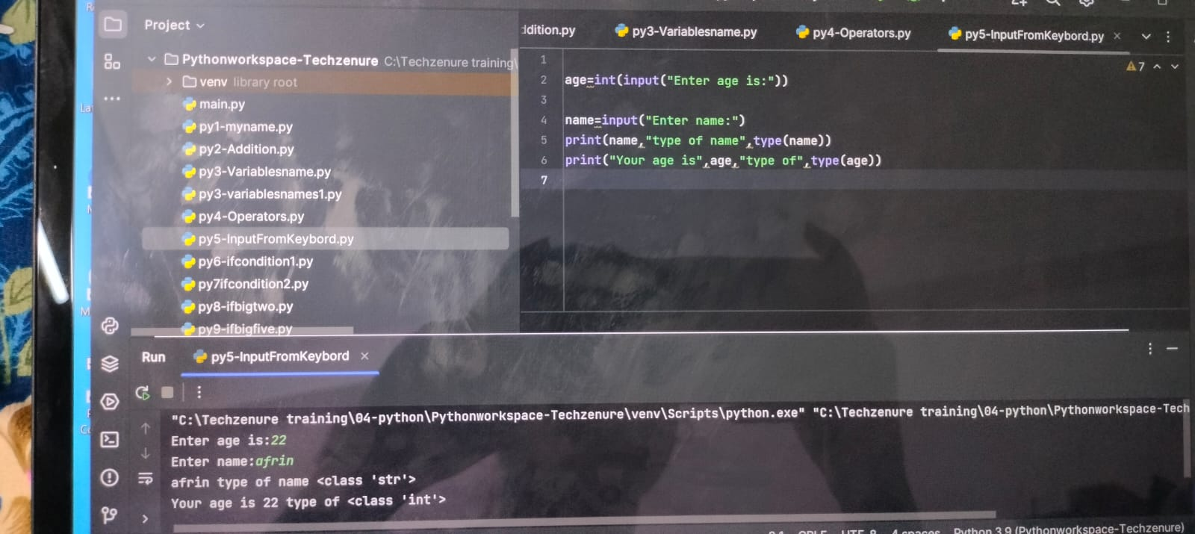
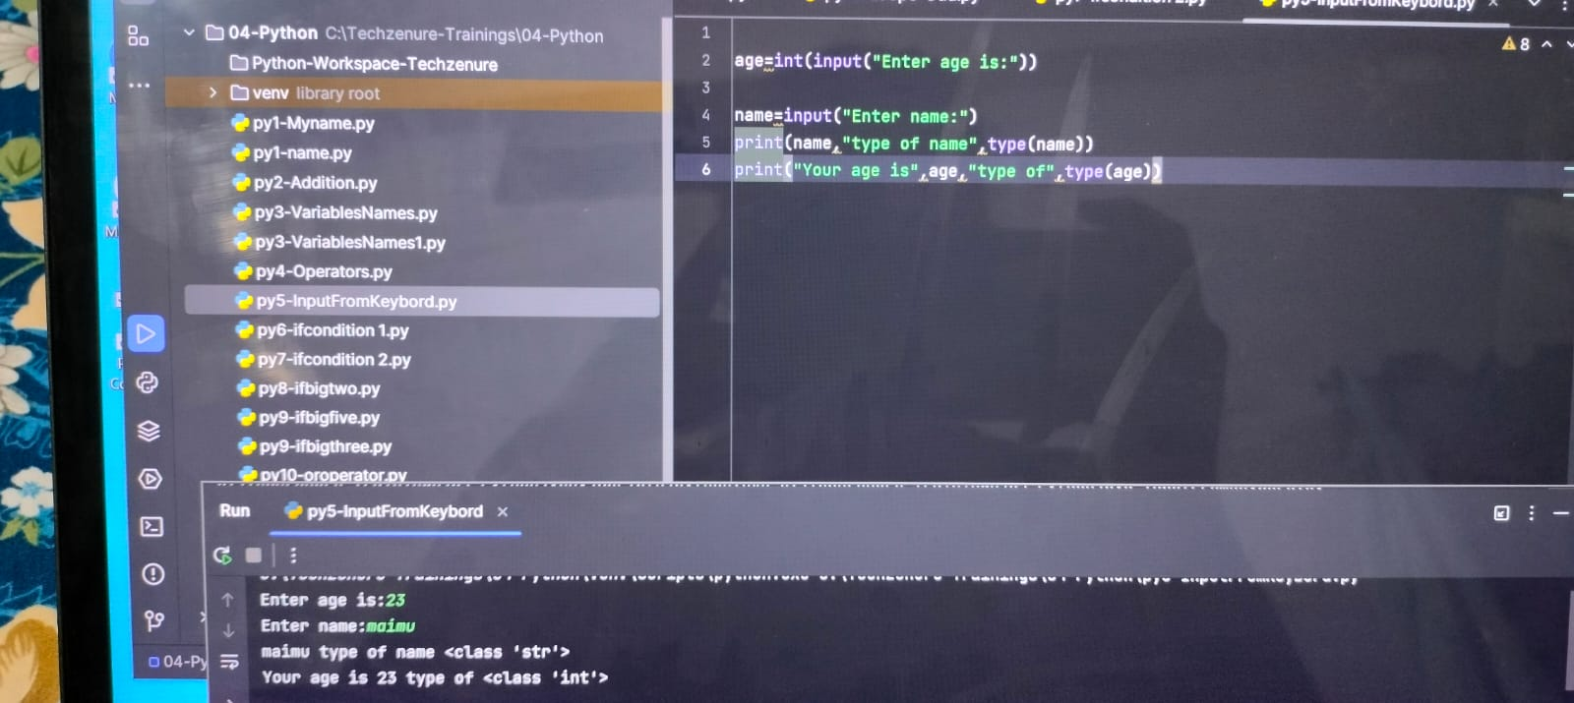
Input from keyboard program:-

Slide 34
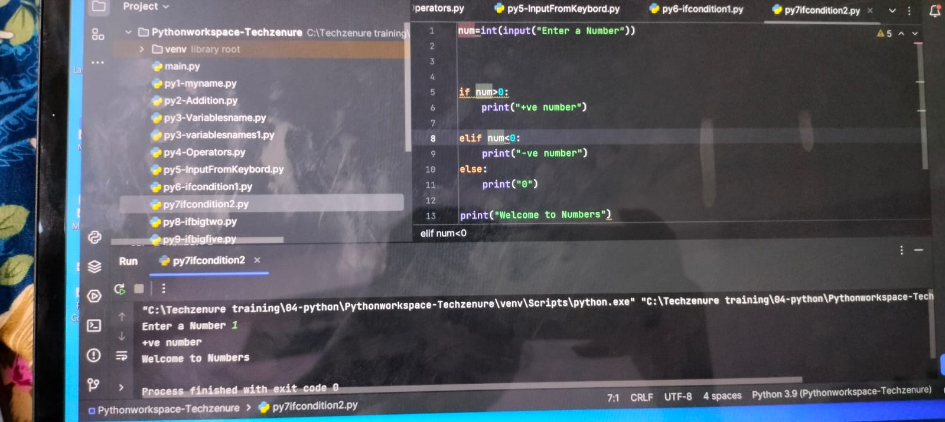
Ifcondition program:- checks the and if it is true then one set of block is executed else another set of block is executed.

Slide 35
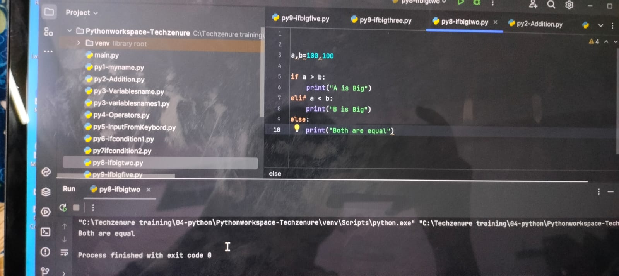
If big two program:-

Slide 36
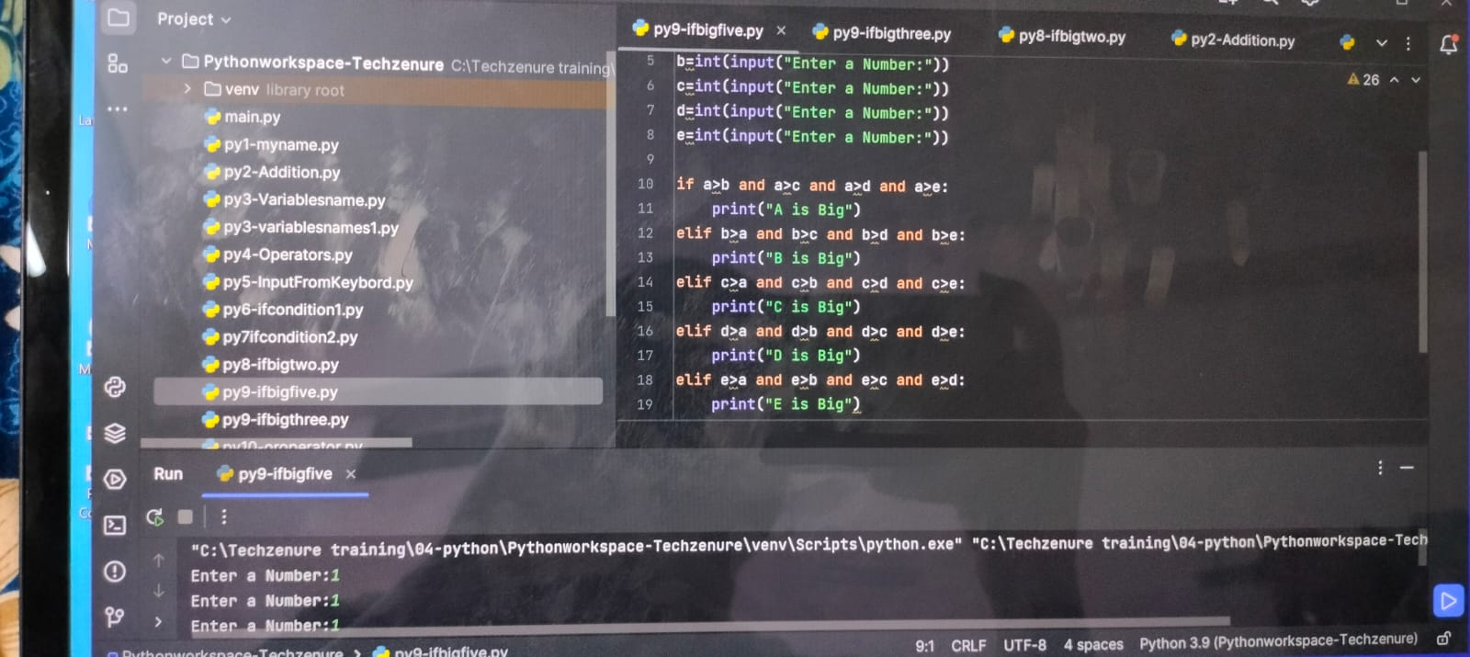
If big five program :-

Slide 37
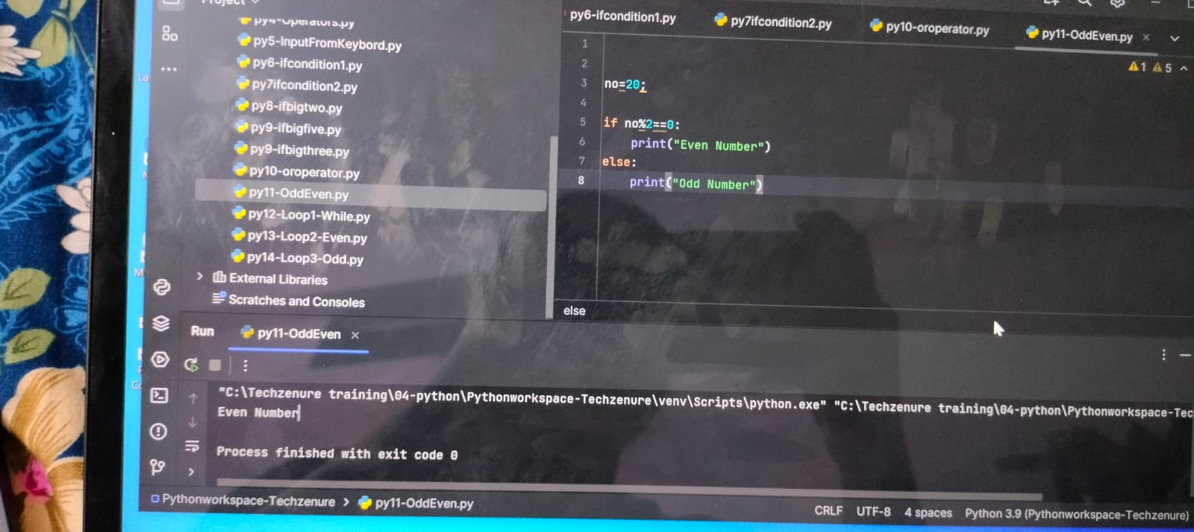
Odd or Even program:-

Slide 38
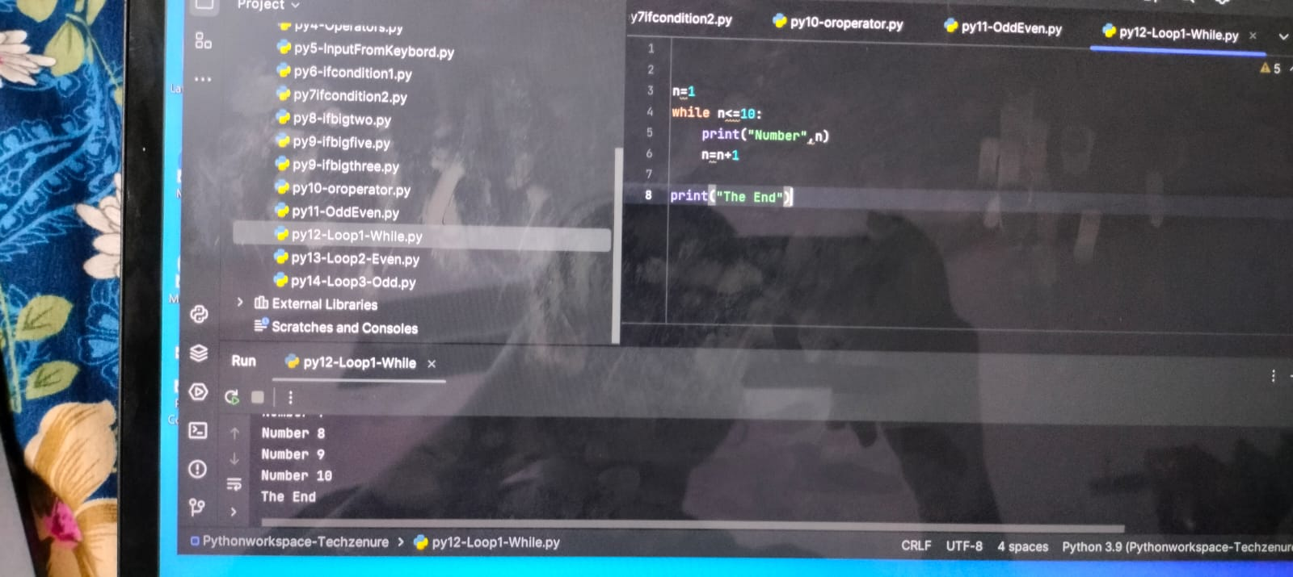
While Loop program:- The while loop is used to iterate a part of the program several times.

Slide 39


